Slide 1
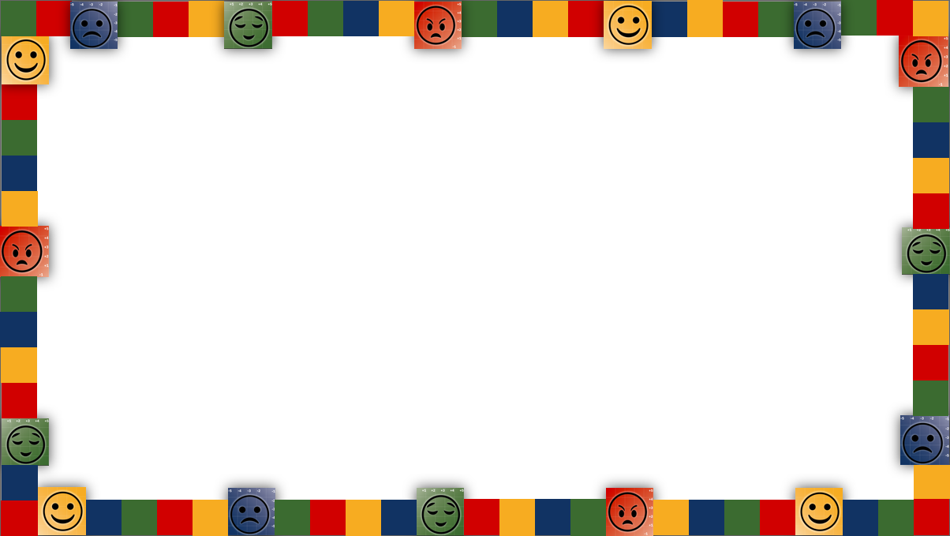


201: Anchor Tools Workshop
EPS Learns | August 21, 2024

Slide 2

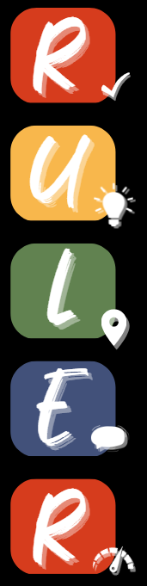
Let’s Review the RULER Skills
Recognizing emotions in ourselves and others
Understanding the causes and consequences of emotions
Labeling emotions accurately
Expressing emotions appropriately
Regulating emotions effectively

Slide 3


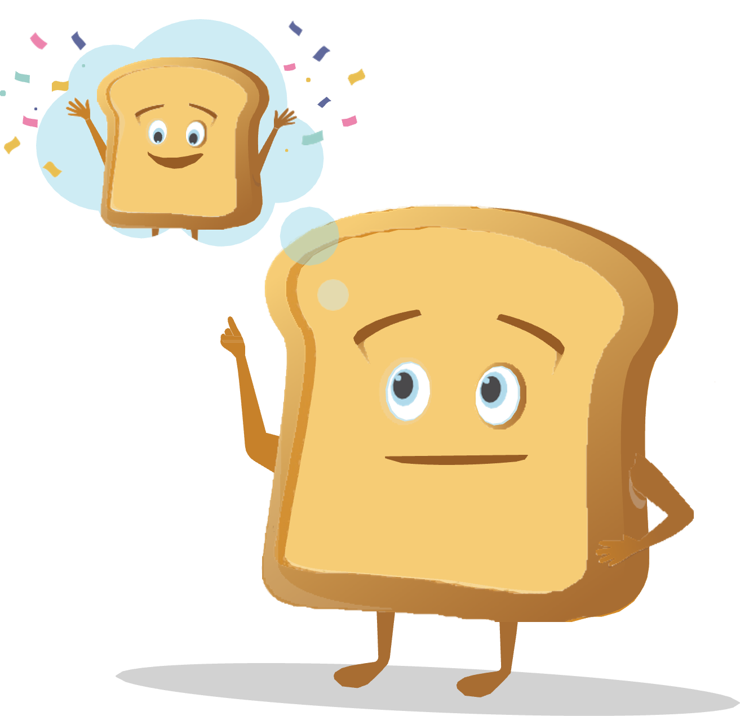

Let’s Review the RULER Anchor Tools
The Charter represents agreed-upon norms for how everyone in a school, classroom, or other environment wants to feel. The Charter also explains what needs to happen or change to build and sustain positive emotional climates.
The Mood Meter is a visual guide to help individuals accurately analyze and “plot” their feelings. The Mood Meter develops skills in recognizing and labeling emotions, which can be further developed into understanding, expressing, and regulating emotions.
The Meta-Moment is a process for responding to emotional triggers in ways that align with one’s best self. The goal is to shift from automatic, unhelpful reactions to strategic, effective responses.
The Blueprint is a problem-solving tool for working with interpersonal conflicts. The Blueprint can be used independently or collaboratively to enhance empathy and identify effective solutions for past, real-time, or anticipated conflicts.

Slide 4

The Mood Meter

Slide 5
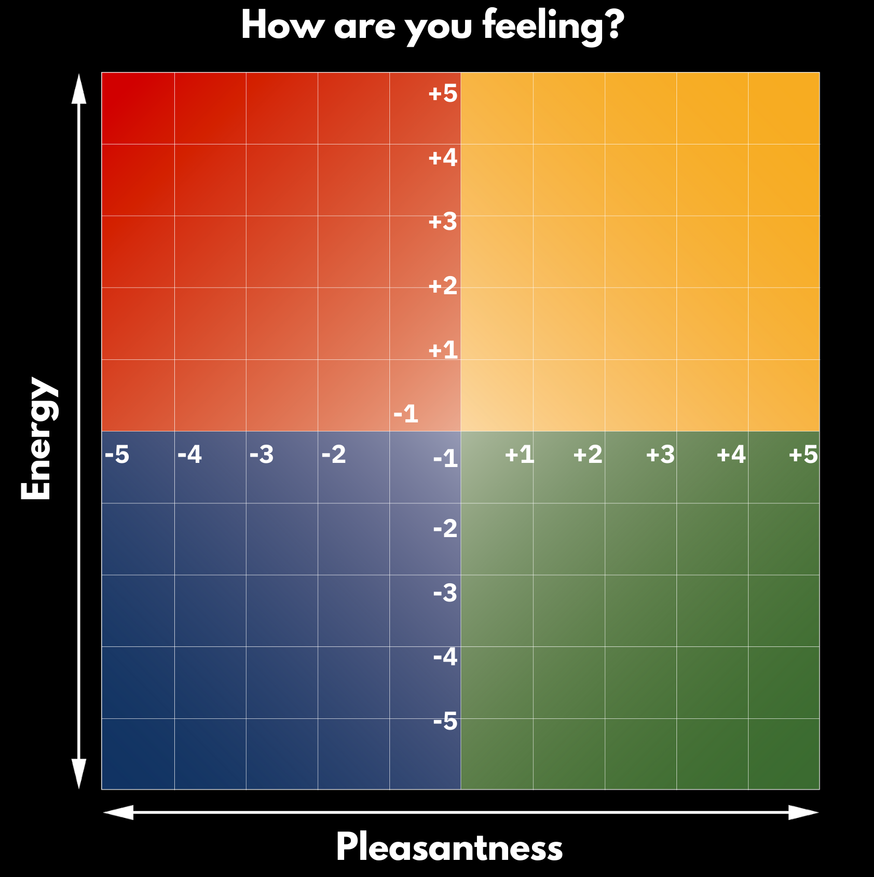




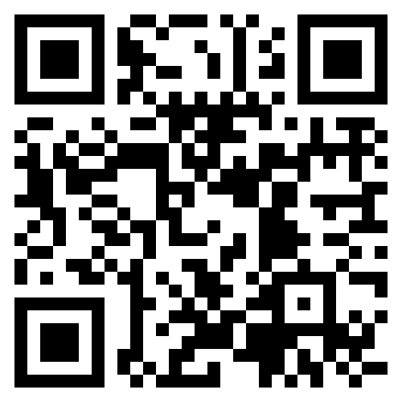
The Mood Meter
New Hire Orientation
EPS Learns
August 21, 2024
Please go to:
moodmeter.online
...and enter the group plot code:
7wx3xd
Or access the QR code

Slide 6
The Value of the Mood Meter
Recognize and label emotions
The mood meter uses a colorful grid with four quadrants to help people identify their emotions by their energy level and pleasantness. Each quadrant represents a different emotional state, such as high energy and unpleasant emotions, or low energy and pleasant emotions.
Develop emotional vocabulary
As people use the mood meter, they can learn more feeling words to describe their emotions. They can also learn to use numeric ranges to express how pleasant or energetic they feel.
Teachers can also use the mood meter
to understand how their students are feeling and plan to follow up with them one-on-one. This can help teachers build relationships with their students and elevate their understanding of them.

Slide 7
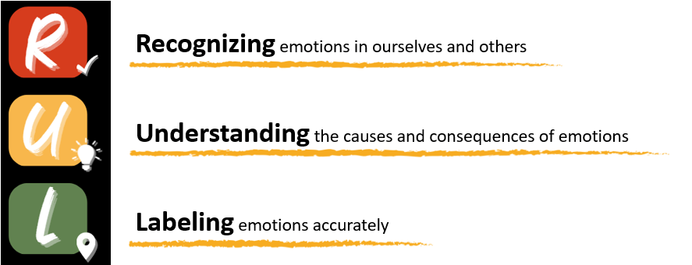
The Value of the Mood Meter

Slide 8
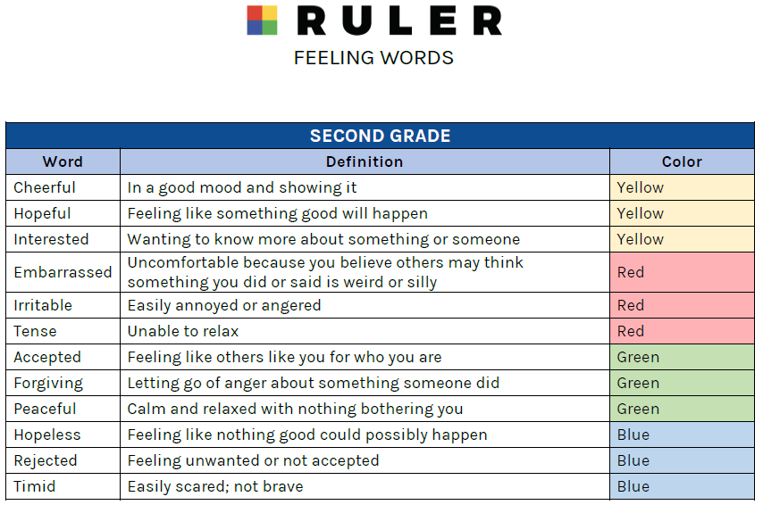
Developing Emotional Vocabulary

Slide 9
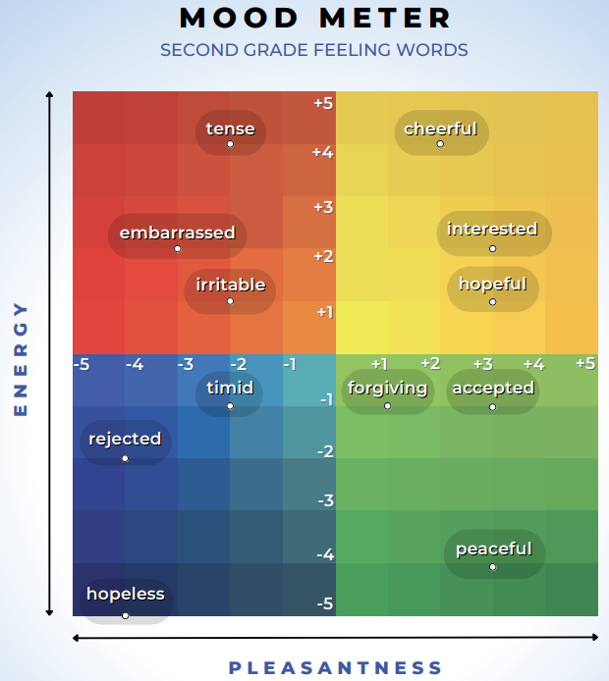
Developing Emotional Vocabulary

Slide 10
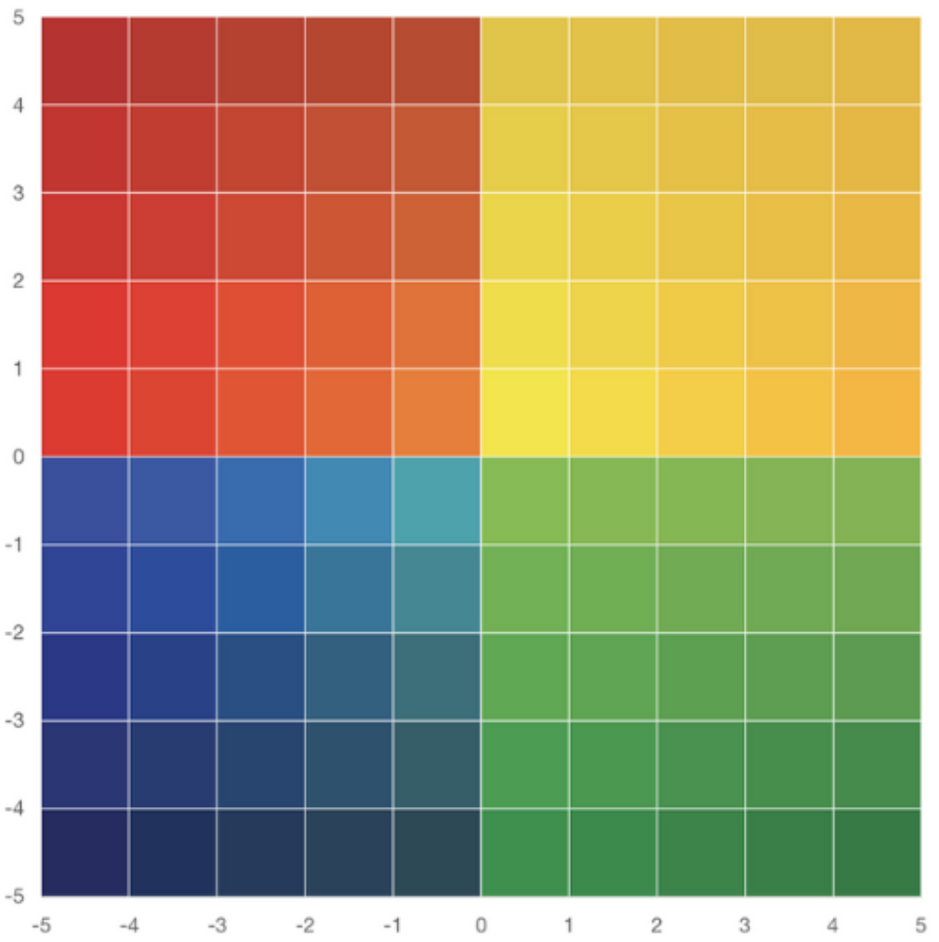
Using the Mood Meter with Curriculum
Plot Lily’s Feelings
Lily sat in her room, her heart heavy and confused. She felt proud of her good grades, but also envious of her sister’s art award. She was relieved her big test was over, but still anxious about her next one. She felt grateful for her friends, yet lonely after they went home.

Slide 11
Using the Mood Meter with Curriculum
Plot Lily’s Feelings
Lily sat in her room, her heart heavy and confused. She felt proud of her good grades, but also envious of her sister’s art award. She was relieved her big test was over, but still anxious about her next one. She felt grateful for her friends, yet lonely after they went home.

Slide 12
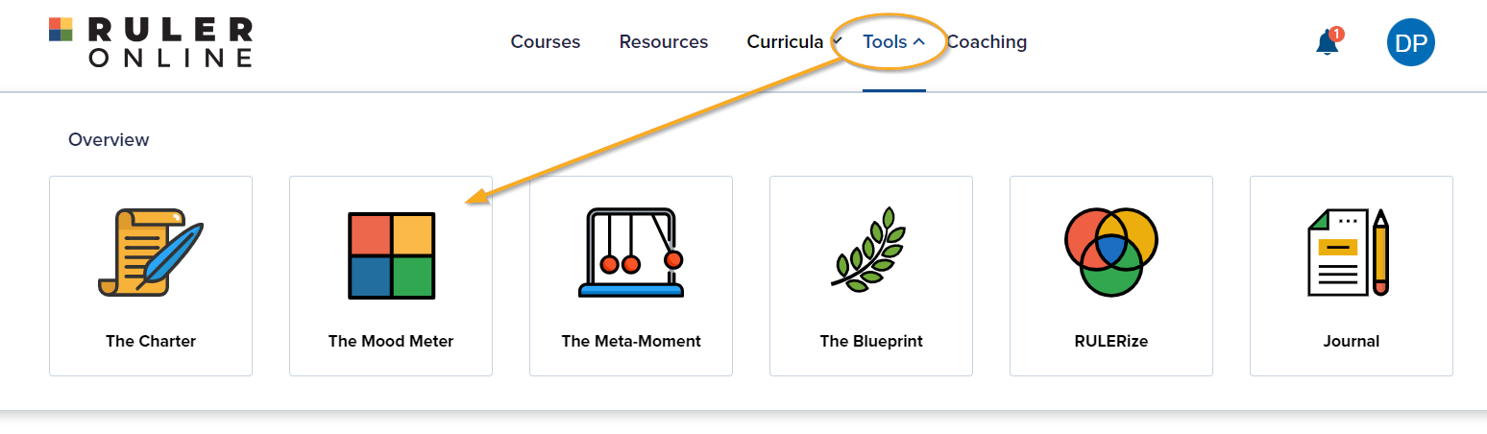
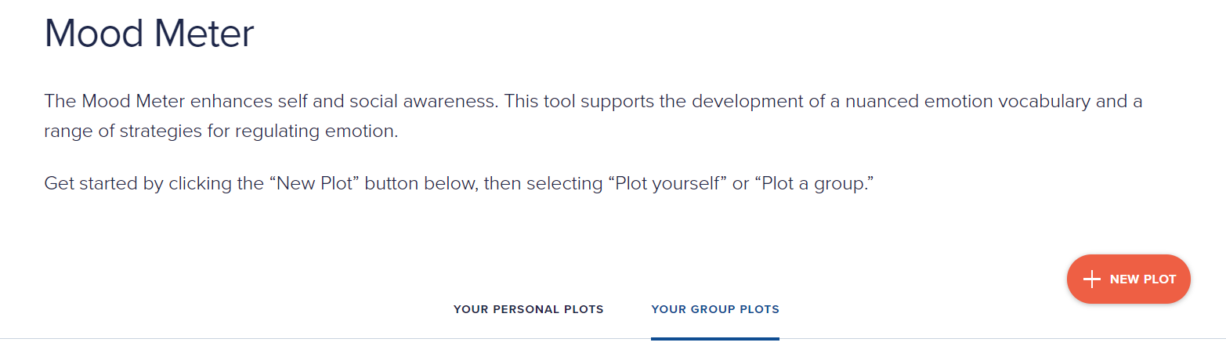
The RULER Online Dashboard

Slide 13

The Charter

Slide 14
Intended Outcomes
By end of this session,
You will gain an understanding of:
  The value of a Charter
  How to set up a Charter
  The importance of revising your Charter
You will be better equipped to:
  Contribute to an environment that will help students…

Slide 15
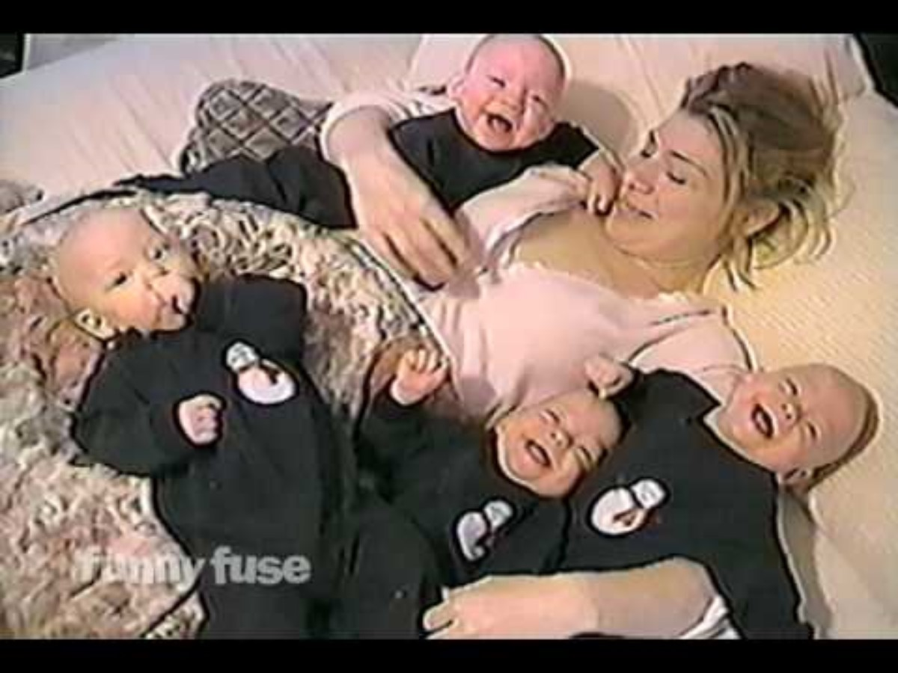
Introduction to Co-Regulation

Slide 16
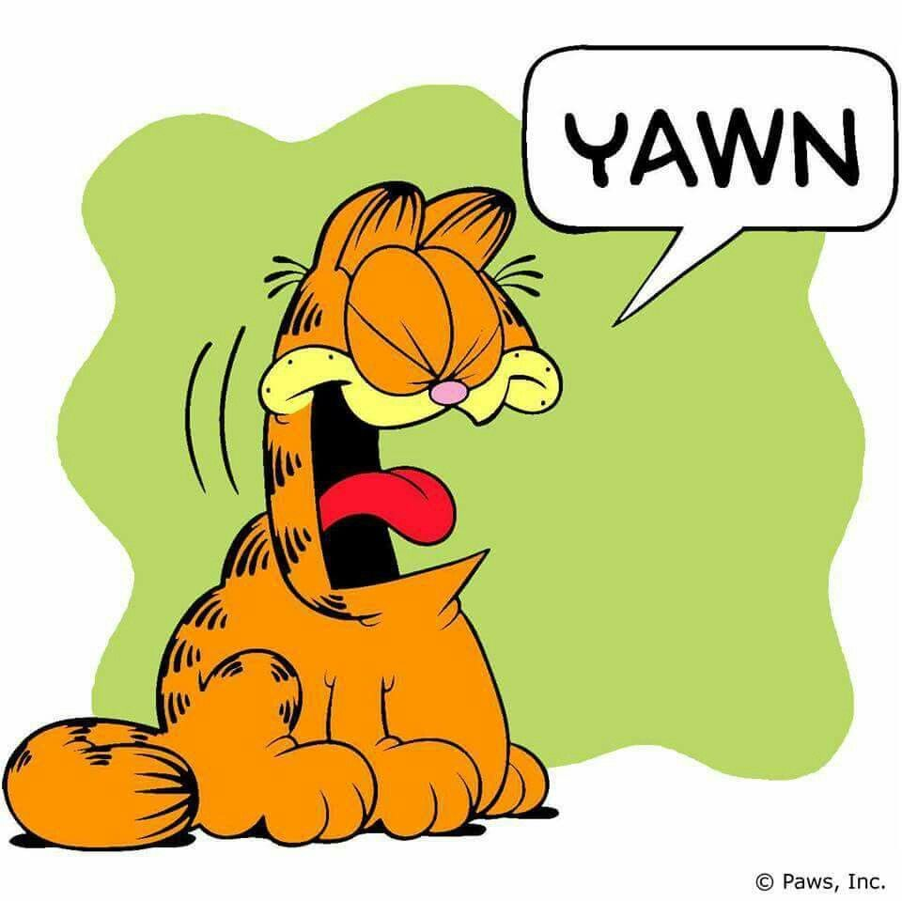
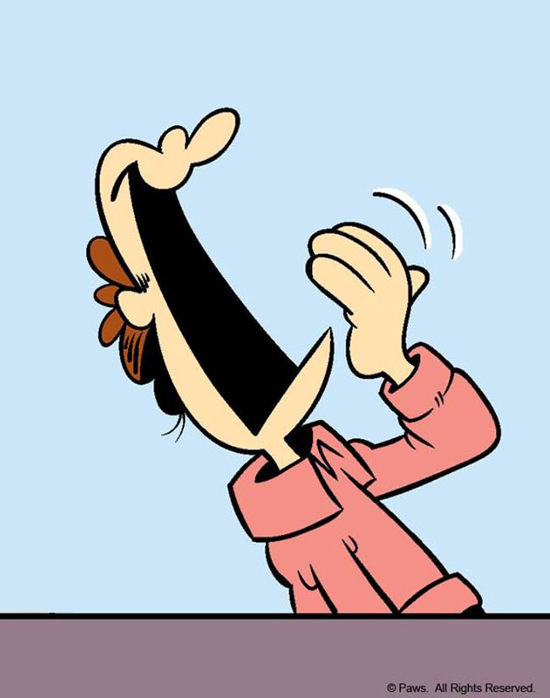
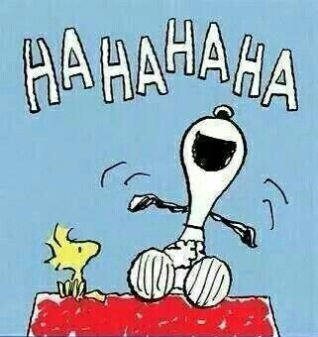
Influencing the Emotions of Others
Are Emotions Contagious?
Who believes that emotions can be contagious?
What some examples of emotions that are contagious?
How might situations be important if someone is influencing the emotions of others on purpose? On accident?

Slide 17

The Biology of Co-Regulation
https://youtu.be/YTTSXc6sARg

Slide 18

The Essential Focus of the Charter
When co-regulation works well, both people experience less distress.
For example, if you were running a long race with a friend,
you might adjust to each other’s speeds. If either of you
felt like giving up, your might persist longer because
you have each other’s support.

Slide 19
The Essential Focus of the Charter
Example 1: Someone accidentally bumps into you in line, and you can tell that they are in a down mood.
You let them go in front of you. This causes the person to say “thank you” and smile, which makes you feel gratified.
Example 2: You see that a classmate who is giving a presentation is very nervous and struggling to speak in front of the class.
You choose to be extra cooperative, quiet, and attentive to help them feel better, which calms them down and makes you feel satisfied.

Slide 20

The Essential Focus of the Charter
Co-regulation plays an important role in how we help each other to feel the words listed on our Charter.
When two people interact, they are constantly influencing, responding, and adjusting to each others’ behaviors.
Our individual emotions are constantly changing, depending on others’ emotions and behaviors.
Co-regulation can be between a
parent and child, two friends, or
between a teacher and student.

Slide 21

The Essential Focus of the Charter
Remember…
We aren’t only responsible for regulating our own emotions and behaviors at school. We all play an important role in helping each other to manage our feelings.
…This is where the Charter comes in.

Slide 22
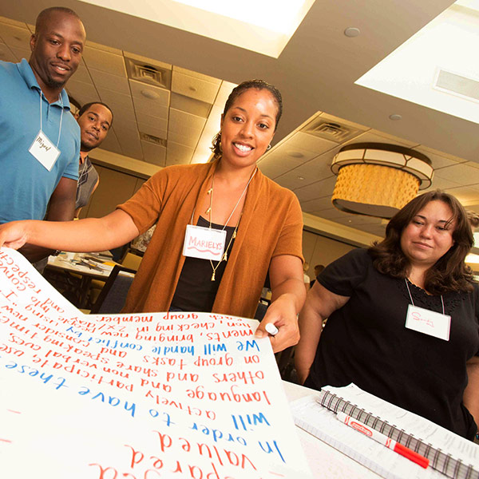
The Charter
There is a clear gap between how school community members feel and how they want to feel. This presents us with an opportunity–a call to action to develop plans for enhancing emotional climates.
This is where the Charter comes in. The Charter allows everyone in a school community the chance to articulate how they want to feel at school, then work together to agree upon behaviors that support those feelings. As a group, the school community members decide on what needs to happen or change for those feelings to be consistently present.
All Charters are structured around two primary
questions:
  How do we want to feel?
  How will we help each other to
  experience these feelings?

Slide 23
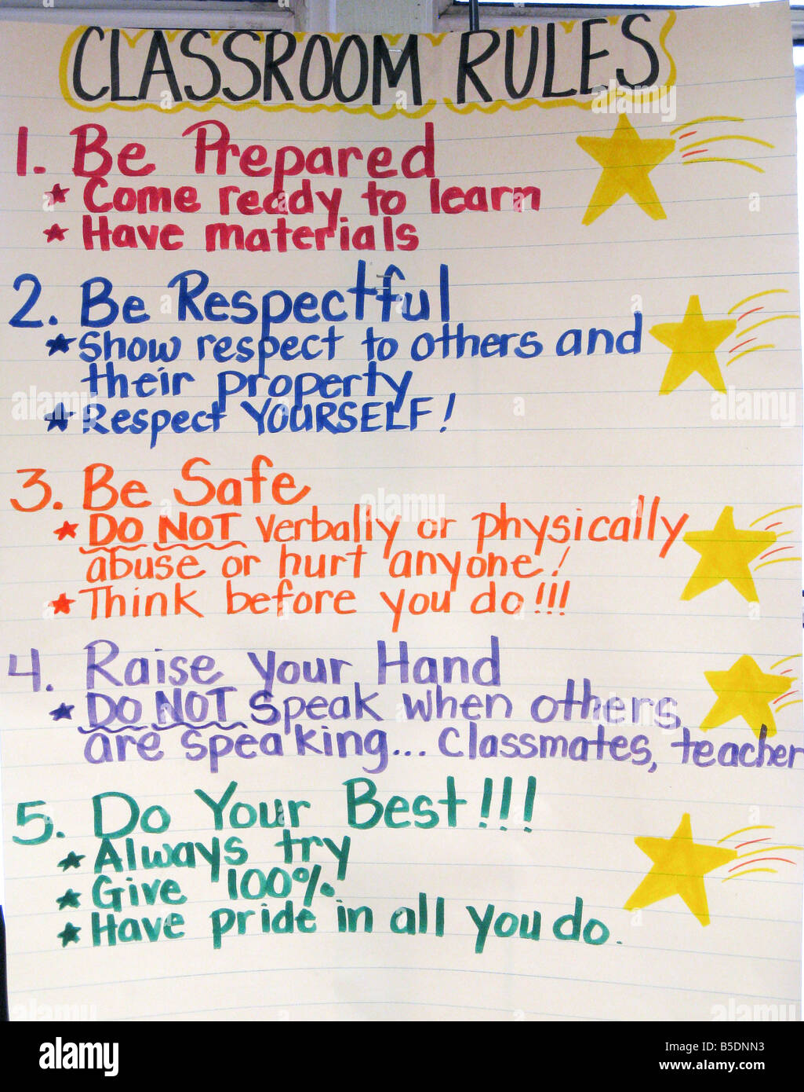
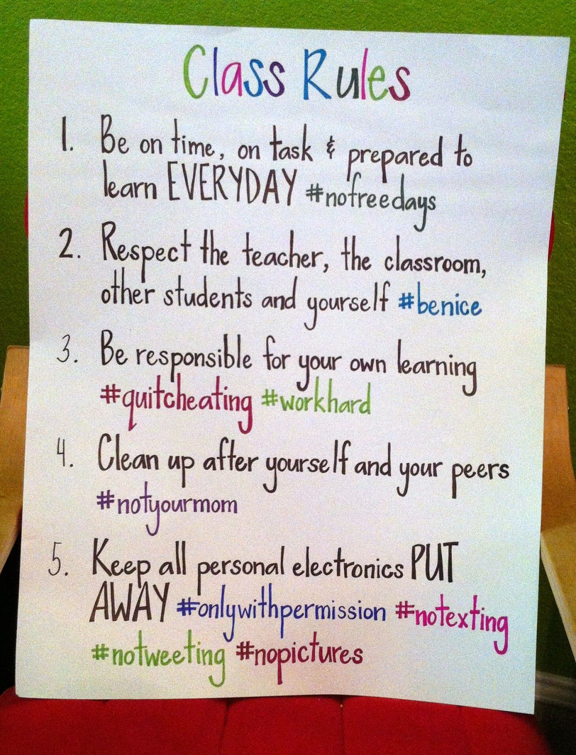
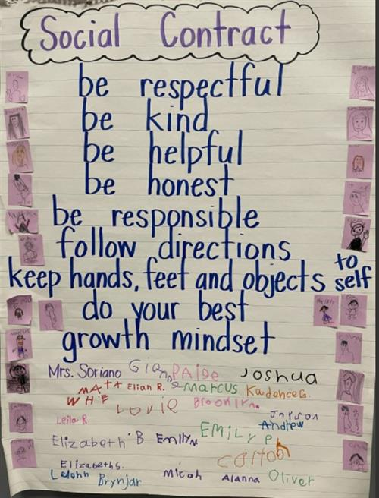
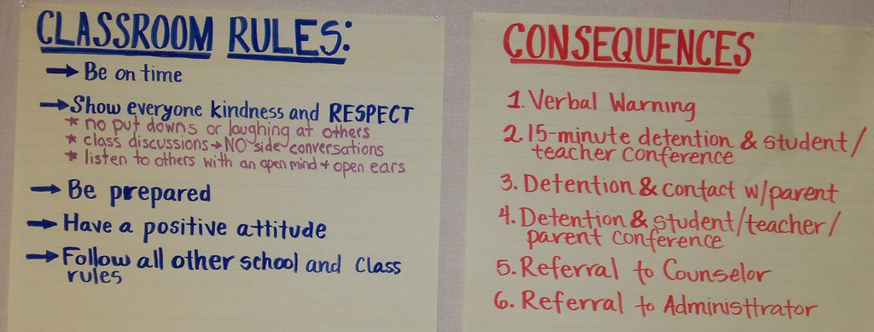
Charters vs. Classroom Rules or Social Contracts

Slide 24
The Value of a Charter
The Charter creates the WHY for the classroom rules or social contract. How we want to feel will lead into strategies that will foster and maintain them. The “rules” naturally follow – but rather than for basic compliance, they will have a deeper level of meaning and purpose.

Slide 25
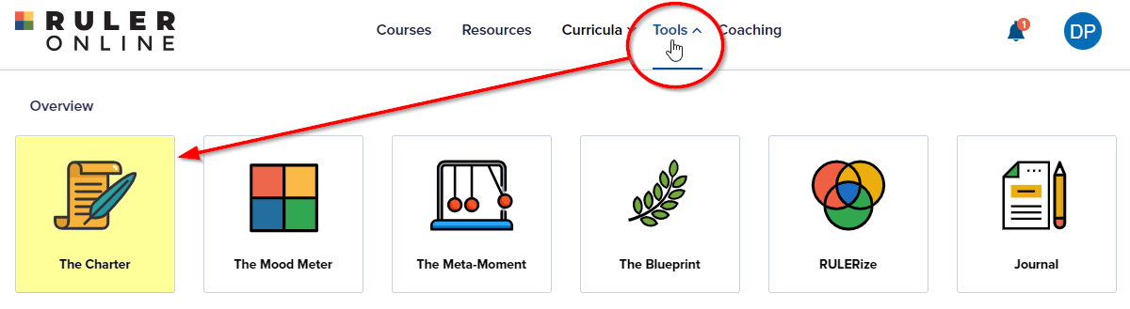
Creating a Charter

Slide 26
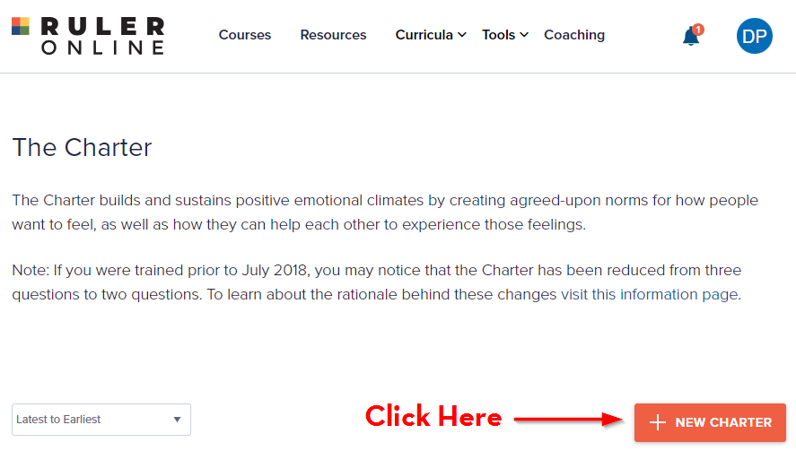
Creating a Charter

Slide 27
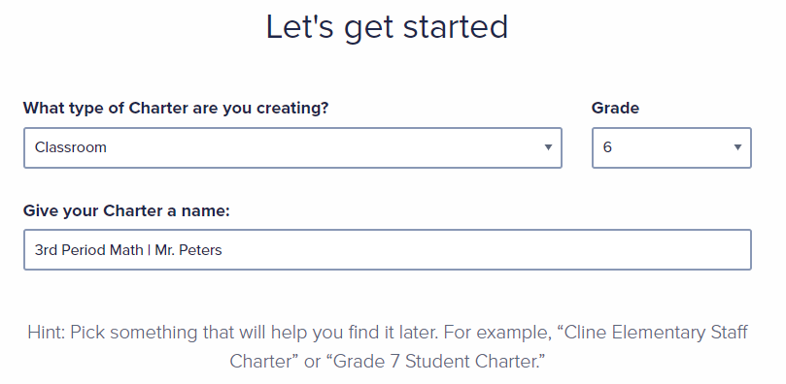
Creating a Charter

Slide 28
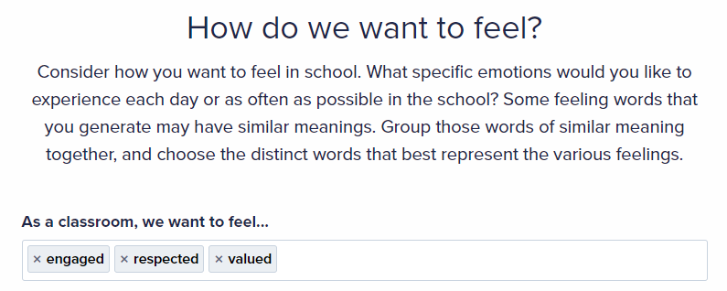
Creating a Charter

Slide 29
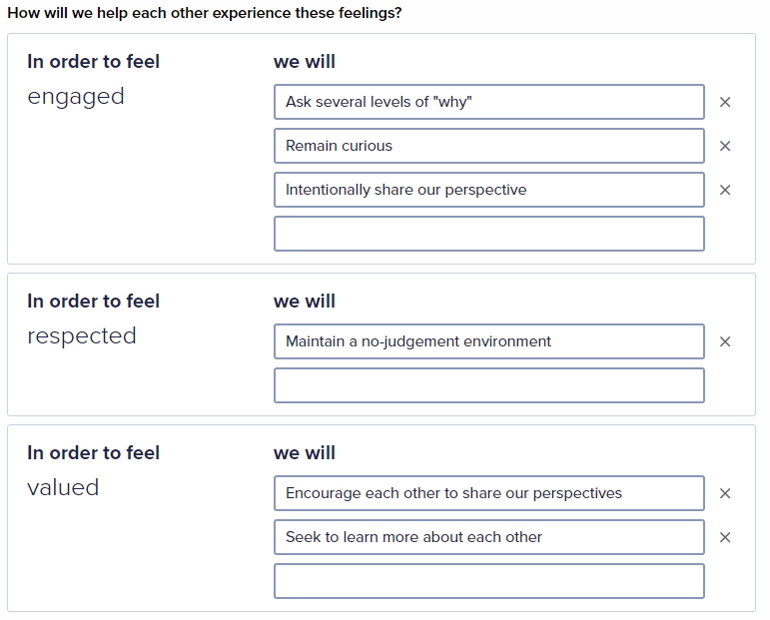
Creating a Charter

Slide 30
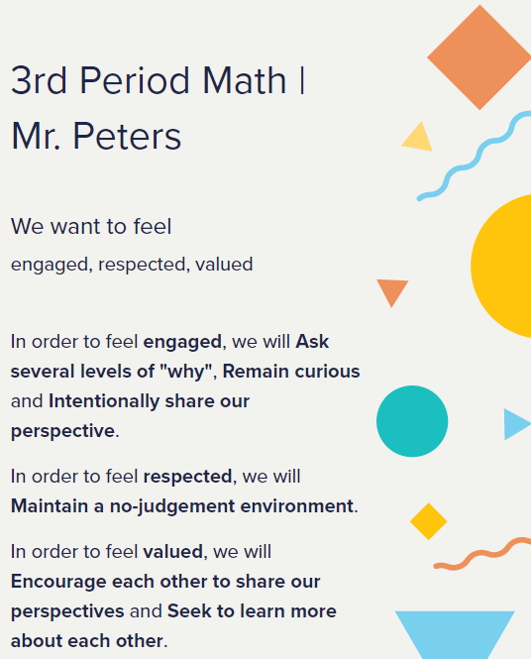

Creating a Charter

Slide 31

Keeping the Charter Alive

Slide 32

The Meta-Moment

Slide 33
Intended Outcomes
By end of this session,
You will gain an understanding of:
  The phases of the Meta-Moment Tool
  The value of activating your “best self”
  How to develop its use into a habit
You will be better equipped to:
  Contribute to an environment that will help students and those around you….

Slide 34
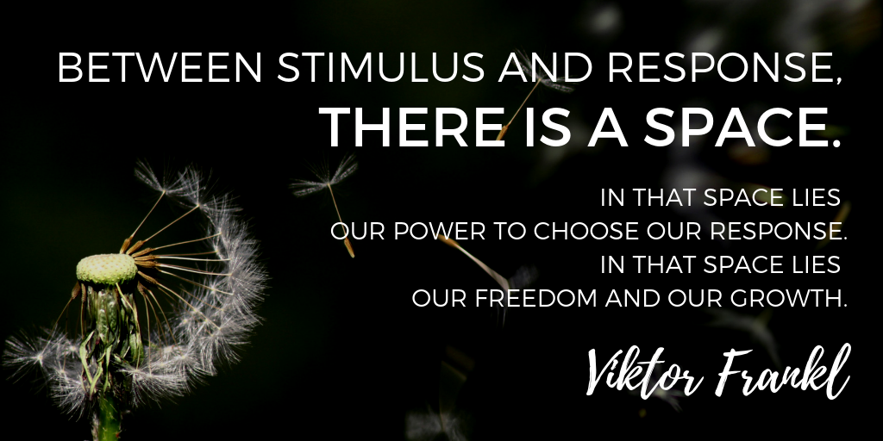
The Meta-Moment

Slide 35




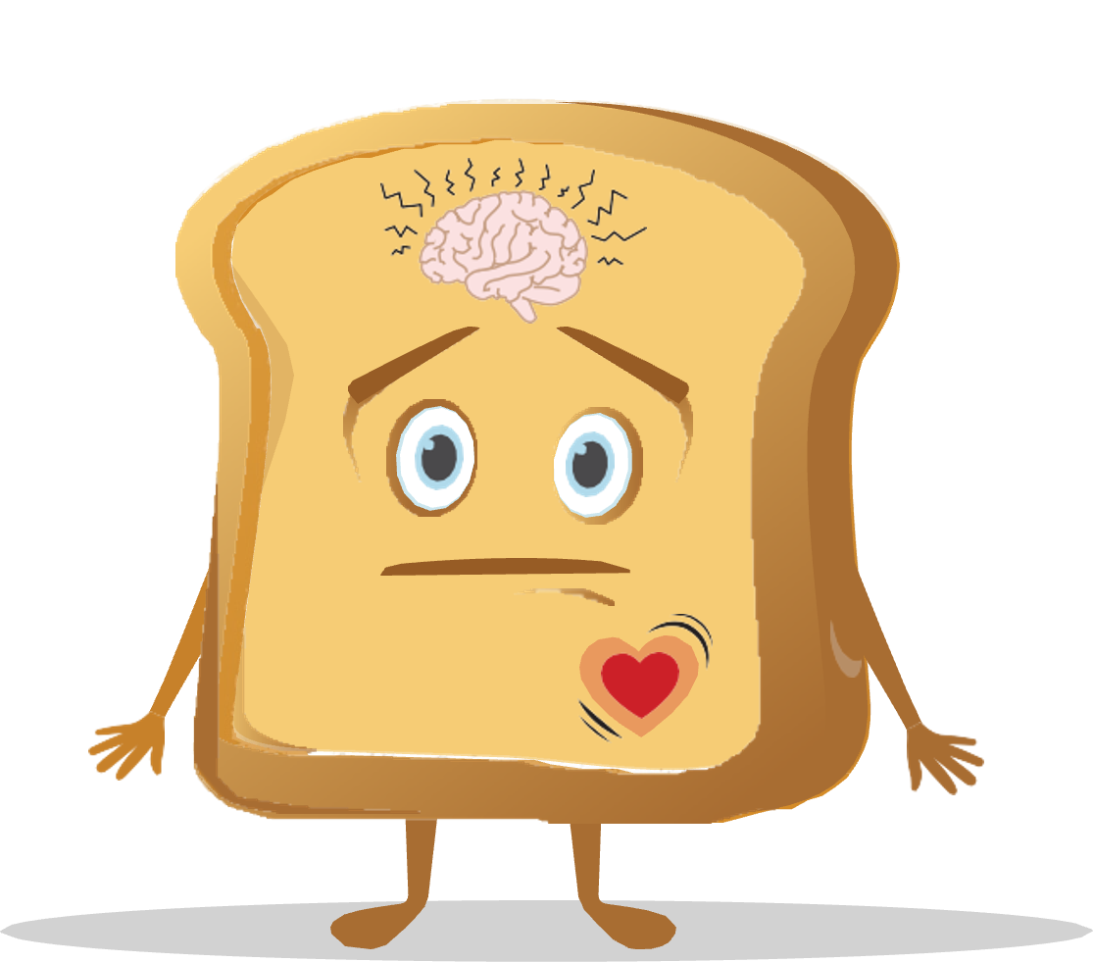
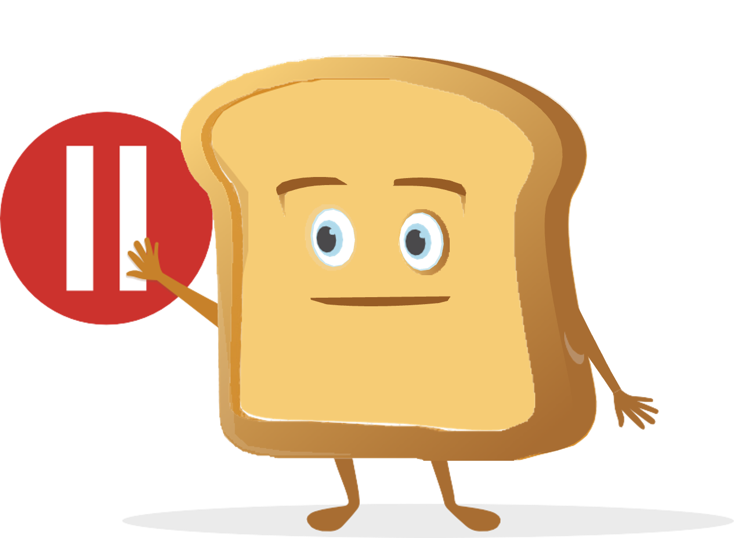
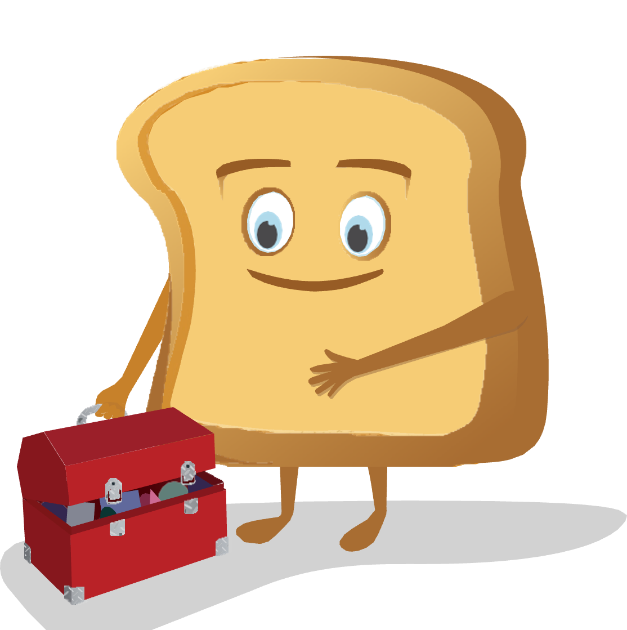
The Meta-Moment
The Meta-Moment consists of four steps:
  Sense that something has happened or changed in your environment
  Pause to de-escalate and avoid responding in an unhelpful manner
  See your best self, or visualize a positive image of yourself
  Strategize and act in a more helpful manner

Slide 36
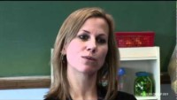
A Meta-Moment Story
https://youtu.be/yKXLEJqxUxw?t=7

Slide 37

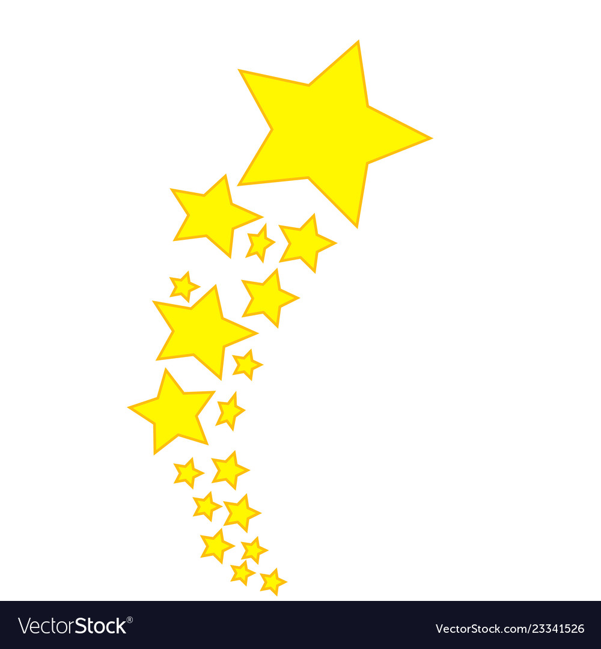
Opportunity for Reflection
Think of a situation between you and someone else in which you would have appreciated if they would have used a meta-moment during their interaction with you.
Think of an interaction in the past that could have had a more productive outcome if you had taken a meta-moment for yourself.
What are examples of barriers to taking a meta-moment?

Slide 38
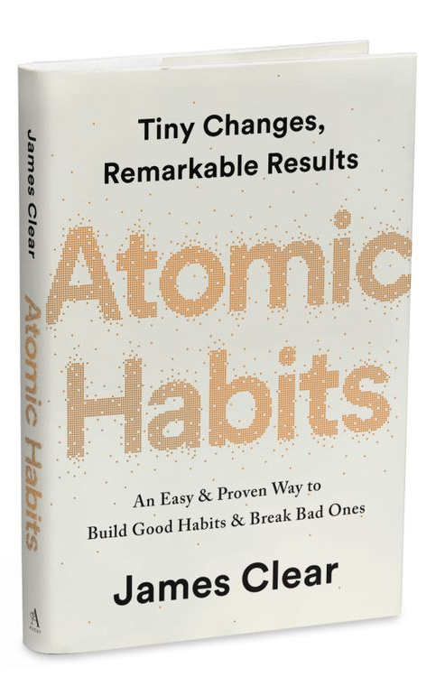
Making Meta-Moments a Habit
Habits are the compound interest of self-improvement. Getting 1% better every day counts for a lot in the long-​run.
Habits are a double-​edged sword. They can work for you or against you, which is why understanding the details is essential.
Small changes often appear to make no difference until you cross a critical threshold. The most powerful outcomes of any compounding process are delayed. You need to be patient.
If you want better results, then forget about setting goals. Focus on your system instead.
It’s not about what you want to do as much as who you want to be!

Slide 39



Goals are Overrated
Problem #1: Winners and losers have the same goals.
Problem #2: Achieving a goal is only a momentary change.
Problem #3: Goals restrict your happiness.
Problem #4: Goals are at odds with long-term progress.
You don’t rise to the level of your goals.
You fall to the level of your systems.

Slide 40

Laws of Behavior Change
Identity Model
Improvements are only temporary until they become part of who you are
In the beginning, it is far more important
to focus on a desired identity than a
particular result
Every action you take is a vote for the
type of person you wish to become.

Slide 41


Critical Threshold of Change
Breakthrough moments are often the result of many previous actions, which build up the potential required to unleash a major change.

Slide 42

A Meta-Moment Story
https://youtu.be/L12b5JoRT6I

Slide 43
Reflection & Application
Using Meta-Moments in a responsive way takes repeated practice, which is why it’s helpful to try them out on lower stress situations first (taking a Meta-Moment when sitting in traffic) versus higher stress ones (a student pushes your hot button in front of the whole class).
Personal Reflection Activity:
What are some steps you will take to
create a habit of taking meta moments?
What are some ideas you have for teaching & reinforcing the Meta-Moment with students?

Slide 44
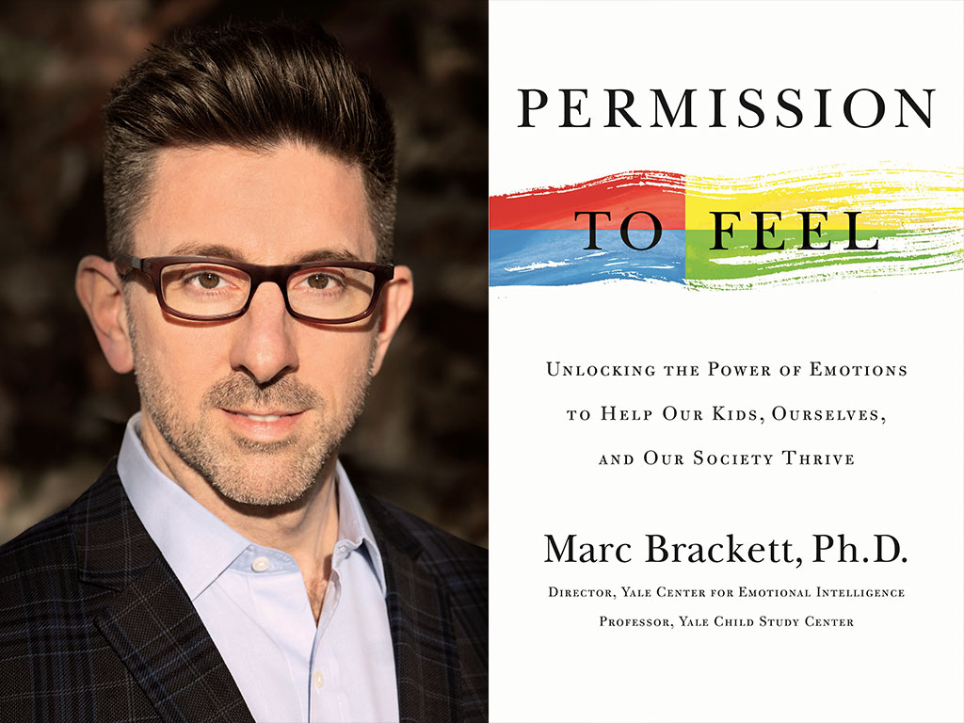

Closing Thoughts from Marc Brackett
Marc Brackett (from Permission to Feel)
I think Mike Tyson had it right when he said, “Everybody has a plan until they get punched in the mouth.”
What’s true in the boxing ring is true everywhere else.
It’s easy to say that from now on we’ll master all our emotional responses, until our significant other or cranky child or unreasonable boss triggers us with a word or look, and - suddenly - all the RULER training goes out the window.

Slide 45
Closing Thoughts from Marc Brackett
So, along with permission to feel, we must also
give ourselves permission to fail.
When that happens, we can only try again — take a deep breath or two, envision our best selves, and start over at the first “R” (of RULER).
At such moments, we also need the courage to apologize and forgive ourselves as we’d forgive others. Courage can even mean seeking professional help when all else fails.
We’ll never stop having to work at being our best selves. But the payoff is worth it: better health, better decision making, better relationships …better everything.

Slide 46

The Blueprint

Slide 47
Intended Outcomes
By end of this session,
You will gain an understanding of:
  The purpose and elements of the RULER Blueprint
  How to use the Blueprint with a student and/or within an academic content lesson
You will be better equipped to:
  Contribute to an environment that will help students and those around you….

Slide 48

The Blueprint
We can tap into the restorative potential of conflict by using the fourth RULER tool: the Blueprint.
The Blueprint as a tool for reflecting on conflict and guiding conferences to resolve conflict and help to restore communities
Through answering questions about the conflict, we learn to empathize and consider the situation from the other person’s perspective.
The benefits of empathy and strategies for cultivating empathy, including active listening and paraphrasing

Slide 49
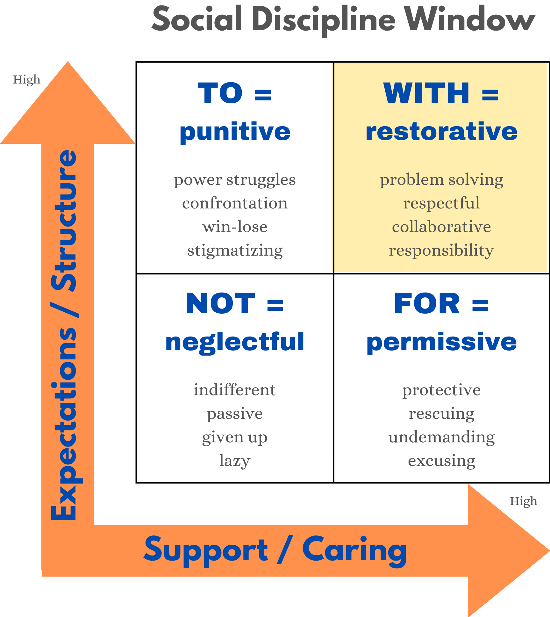
Restorative Practices

Slide 50
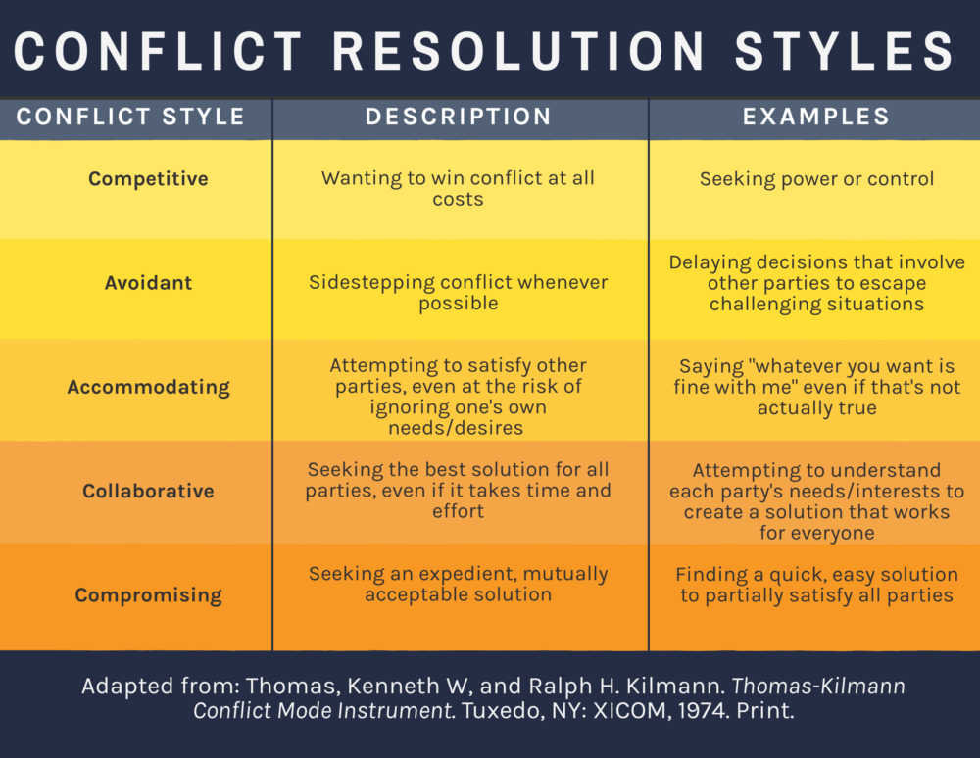
The Blueprint

Slide 51
The Blueprint
Personal Reflection
What is/are your “default” conflict style(s)?
How might this impact someone with the same or different style than you?

Slide 52
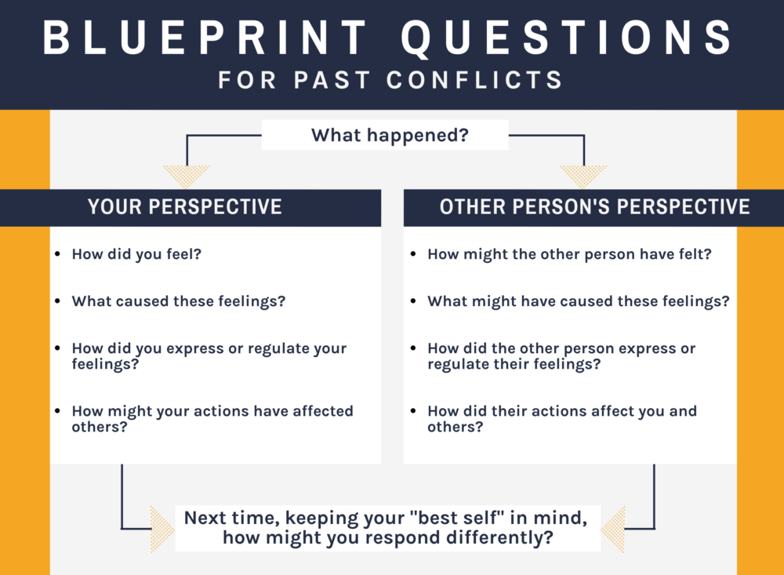
Blueprint Reflection

Slide 53

Active Listening
https://youtu.be/qpnNsSyDw-g

Slide 54
Conflict De-Escalation
Empathy | Putting yourself in someone else’s shoes and experiencing the same feelings as that person. When we are empathic toward others, we try to see things from their perspective.
Conflict De-Escalation Strategies
Remain calm | Respect personal space
Ask the person to share what they are feeling | Empathize with the other person
Give the person choices instead of telling them what to do | Restate/clarify what the person says
Ask about facts instead of emotions | Give the person your full attention
Remember that silence in the conversation is okay | Thank the person for their positivity after the conflict is over

Slide 55
Conflict De-Escalation
Remain calm by using a low, “Green” tone of voice and not speaking over/arguing
Respect personal space – don’t get too close or try to grab something from the person
Ask the person to share the facts and what they are feeling by using open-ended questions. Say, “How can I help you?” or “Tell me what happened” instead of
“Why are you so angry?”
Empathize with the other person’s feelings (not necessarily the behavior). Say, “You have every right to feel frustrated about that.” Avoid addressing the behavior or yelling.
Give the person choices instead of telling them what to do. Instead of forcing an agitated person right into a discussion, try offering a temporary break “Why don’t we take a minute before we continue this conversation?”
Restate/clarify what the person says. Respond selectively, and don’t assume that you know what the person means. Show real interest in what the person has to say.
Give the person your full attention, including body language.
Remember that silence in the conversation is okay – it allows the individual time to figure out responses and to plan how to say what they need to say.
Thank the person for their positivity after the conflict is over

Slide 56
Using the Blueprint with Curriculum
Conflict in Stories, History, and Current Events
Your handout includes a Blueprint Reflection worksheet and two fictional stories (secondary and elementary examples)
The stories each involve two characters and a conflict that develops
Use the Blueprint Reflection worksheet to analyze the feelings and perspectives of each character

Slide 57
Blueprint Reflection

Slide 58
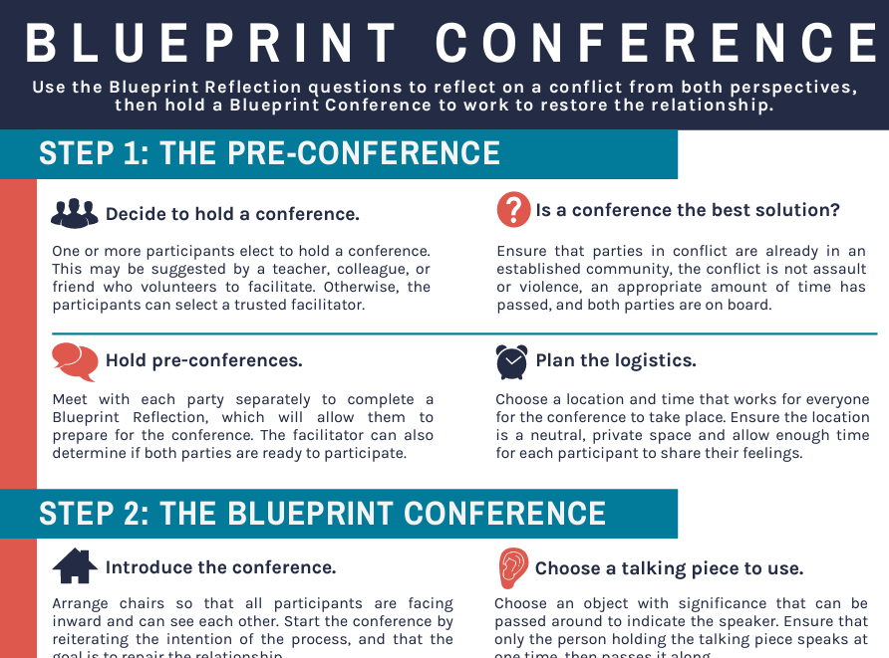
The Blueprint Conference

Slide 59
What Feedback do you have for Next Steps?
The Charter represents agreed-upon norms for how everyone in a school, classroom, or other environment wants to feel. The Charter also explains what needs to happen or change to build and sustain positive emotional climates.
The Mood Meter is a visual guide to help individuals accurately analyze and “plot” their feelings. The Mood Meter develops skills in recognizing and labeling emotions, which can be further developed into understanding, expressing, and regulating emotions.
The Meta-Moment is a process for responding to emotional triggers in ways that align with one’s best self. The goal is to shift from automatic, unhelpful reactions to strategic, effective responses.
The Blueprint is a problem-solving tool for working with interpersonal conflicts. The Blueprint can be used independently or collaboratively to enhance empathy and identify effective solutions for past, real-time, or anticipated conflicts.

Slide 60
